Slide 1
Convolutional Neural Networks (CNNs) and Applications
Dr. J Angel Arul Jothi
Assistant Professor
Department of Computer Science

Slide 2
Agenda
Deep Learning (DL)
CNNs
Applications of CNNs
Steps in building a DL model
Building blocks of CNNs
Training a CNN
Popular Pretrained CNNs
Deep Learning frameworks
Top conferences on Computer Vision

Slide 3
Machine learning (ML)
What is ML?
Branch of artificial intelligence (AI) and computer science
Aims to build computers to imitate the way humans learn and improve automatically through experience
using data and algorithms
ML has become popular nowadays. Why?
The development of new learning algorithms and theory
The ongoing explosion in the availability of data
Low-cost computation

Slide 4
Machine learning
ML methods: uses
Science, technology, commerce etc.,
Evidence-based decision-making across many walks of life, including health care, manufacturing, education, financial modeling, policing, and marketing

Slide 5
Machine learning
ML methods: drawbacks
Constructing a ML system required careful engineering and considerable domain expertise to design a feature extractor that transformed the raw data (such as the pixel values of an image) into a suitable internal representation or feature vector
Feature vector can be used by the subsequent part of the learning subsystem (classifier), to detect or classify patterns in the input

Slide 6
Deep Learning
Representation (Feature) learning method
Allows a machine to be fed with raw data and to automatically discover the representations (features) needed for detection or classification using a general-purpose learning procedure
Have multiple levels of representation

Slide 7
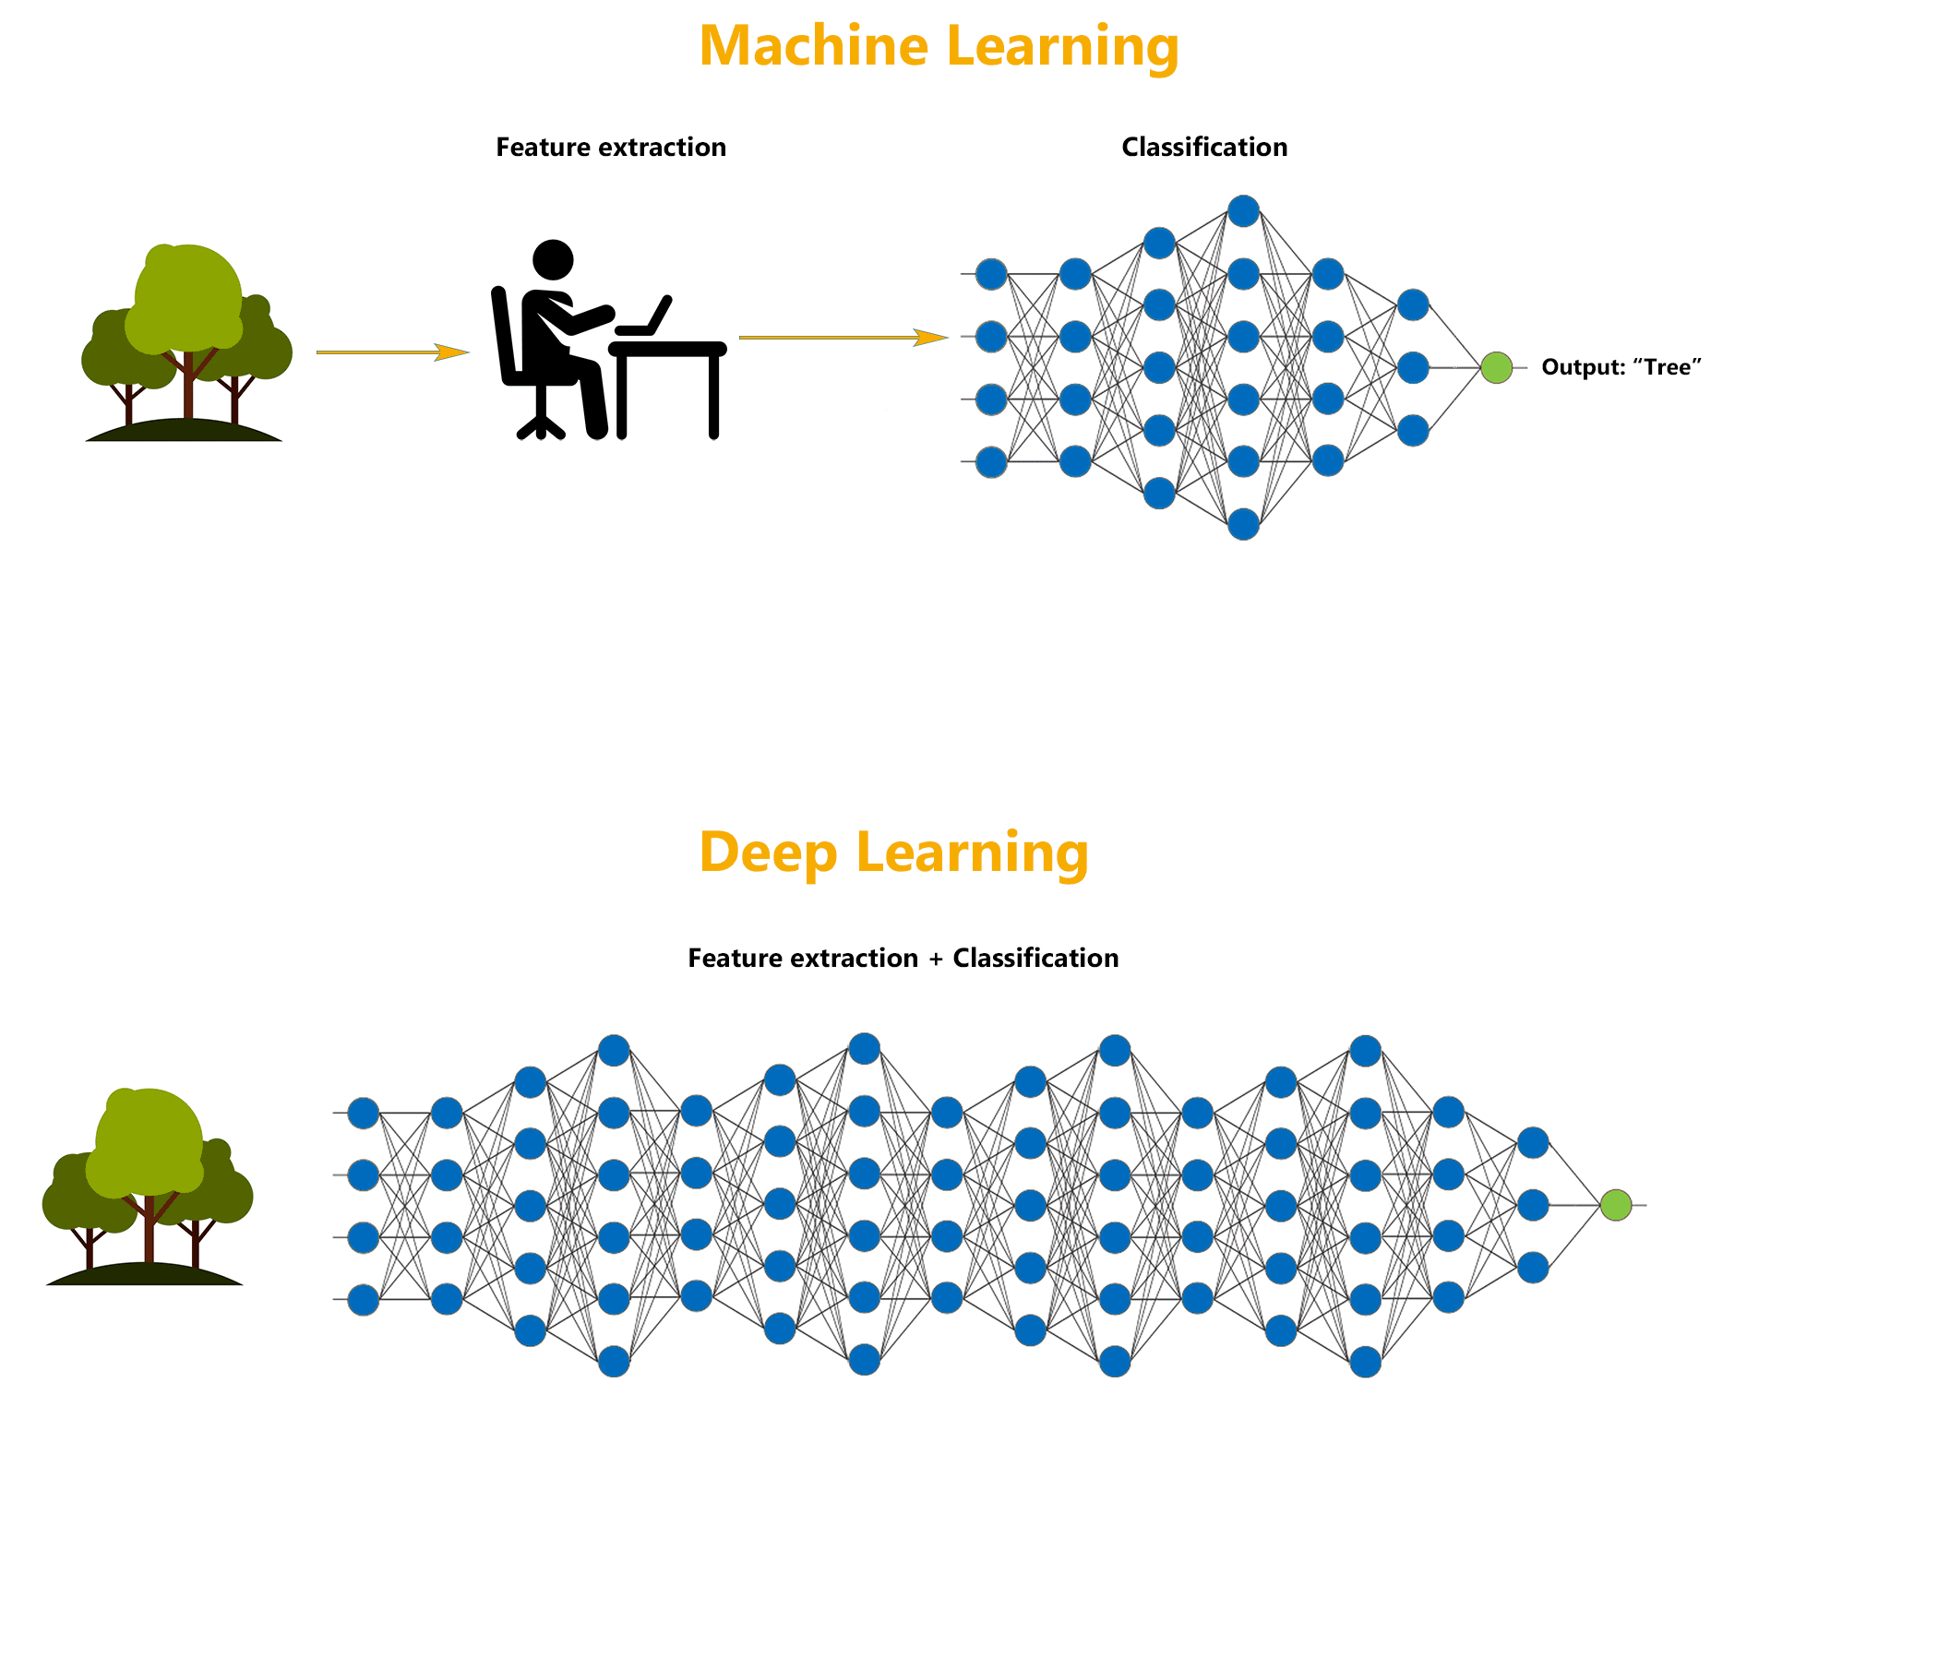
Machine Learning vs Deep Learning
Human picked

Slide 8
Convolutional Neural Networks (CNNs)
Class of deep learning method
Used predominantly in computer vision tasks (processing data that has a grid pattern)
A CNN can do image analysis tasks, including classification, object recognition and segmentation
How did they become famous?
ImageNet Large Scale Visual Recognition Challenge (ILSVRC) in 2012
Object recognition competition

Slide 9
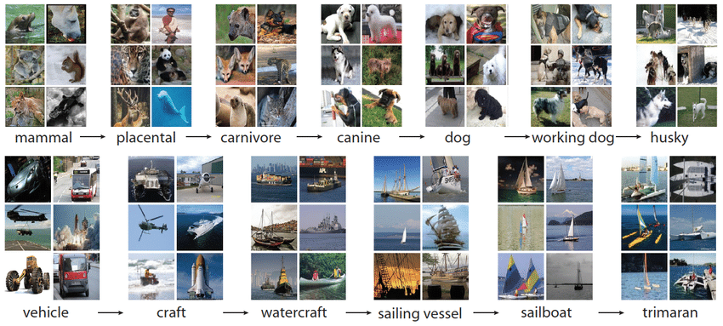
Convolutional Neural Networks (CNNs)
ImageNet Dataset

Slide 10
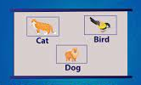
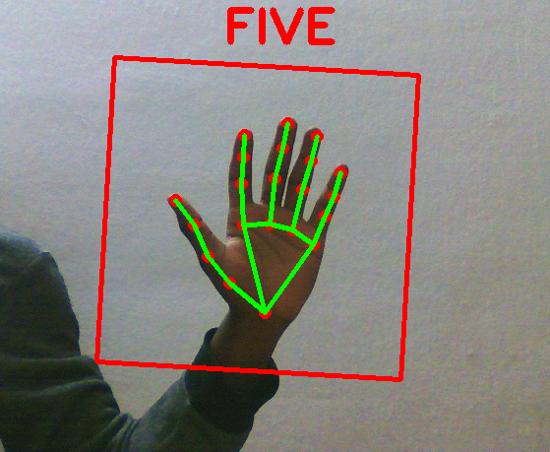
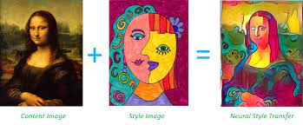
Applications of CNNs
Computer vison based tasks
Document analysis (Character recognition), Object recognition, Segmentation, Image classification, Automatic image captioning, Image based recommender systems, facial recognition, medical image analysis etc.,
Image classification
Sign language recognition
Neural style transfer

Slide 11
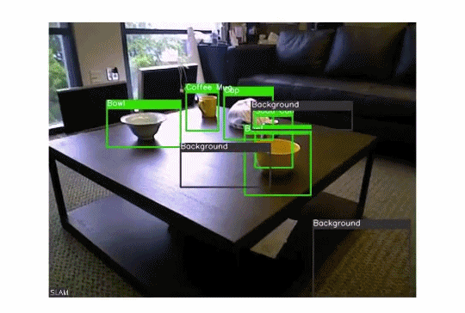
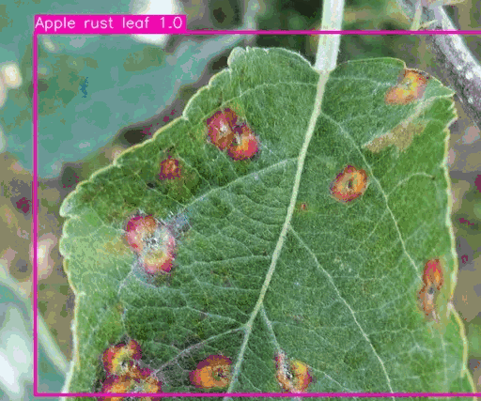
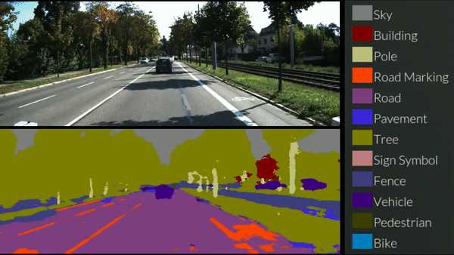


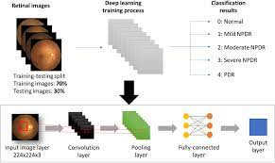
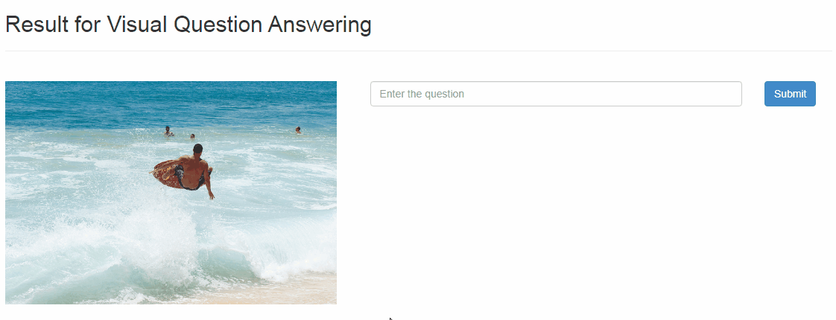
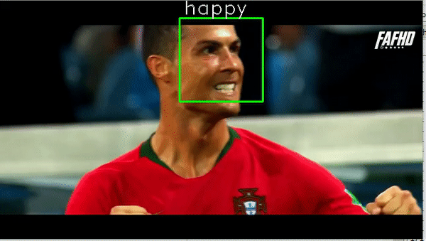
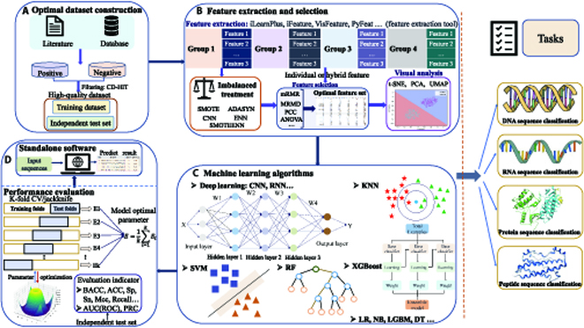
Applications of CNNs
Object Recognition
Autonomous driving
Plant leaf disease detection
Image based recommendation
Virtual try on
Medical diagnosis
Facial Emotion recognition
Visual Q&A system
Biological data processing

Slide 12
Steps in building DL models
Define the model
Train (Inductive) phase: Supply input data so the model learns from it
Testing (Deductive) phase: Evaluate the trained model on new/unseen data

Slide 13
Terminology
Parameter: A variable that is automatically learned during the training process.
Hyperparameter: A variable that needs to be set before the training process starts
Kernel: Set of learnable parameters applied in convolution operations
Bias: A learnable parameter in convolution operation
Weight: Learnable parameter outside of convolution layers. It is a parameter in fully connected layers

Slide 14
Building blocks of CNNs
Repetitions of a stack of several layers
Input layer – Input image
Convolution layers
Pooling layers
Flatten layer
Fully connected layers
Output Layer

Slide 15
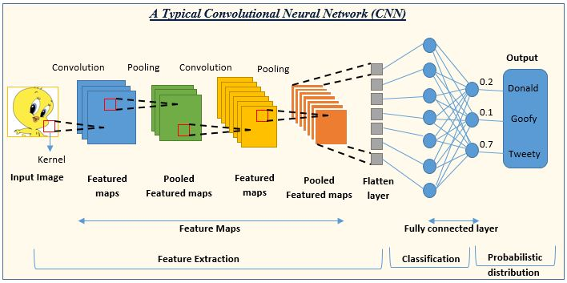
Building blocks of CNNs

Slide 16
Convolution layer
Fundamental component of a CNN
Performs feature extraction
Consists of
A set of filters
Performs
Linear operation (convolution)
Nonlinear operation (activation function)

Slide 17
Convolution layer
Input data to the convolution layer
First convolution layer
Input image - a color image: 3-D (channels) Red, Blue, Green
Subsequent convolution layers
Feature maps from previous layers
Filter/kernel/feature detector
length x width x depth (n) with some values (weights)
n depends on the number of channels in the input
Probable sizes (3 × 3 × n , 5 × 5 × n, 7 × 7 × n)

Slide 18
Convolution layer
Output
A set of feature maps
How is a feature map generated?
A filter is applied across the input to obtain an output feature map

Slide 19
Convolution operation
How is the convolution operation performed?
A filter is applied to the image starting from upper left corner of the image
It moves across the input, checking if a feature is present
An element-wise product is calculated between the input pixels and the filter values (weights) and summed to obtain the output value in the corresponding position of the output feature map
The filter shifts by a stride, repeating the process until the kernel has swept across the entire image

Slide 20
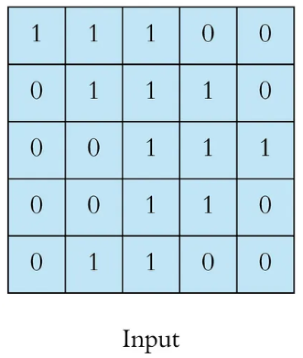
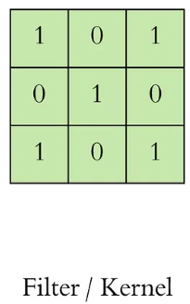
Convolution operation

Slide 21
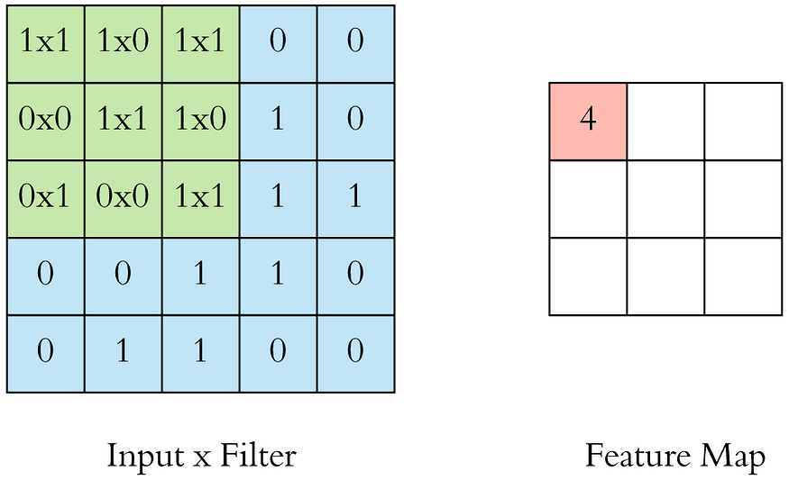
Convolution operation
Element-wise product and sum

Slide 22
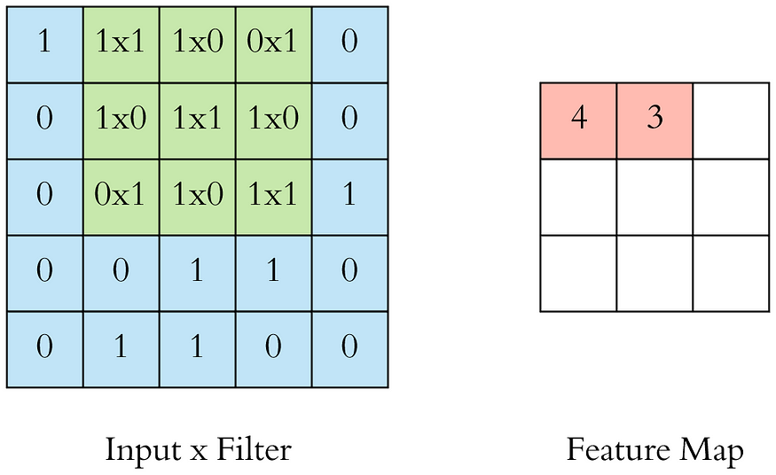
Convolution operation
Element-wise product and sum

Slide 23
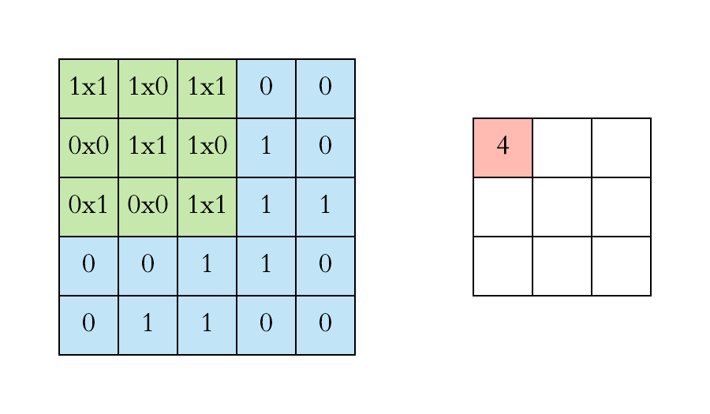
Convolution operation
Element-wise product and sum

Slide 24
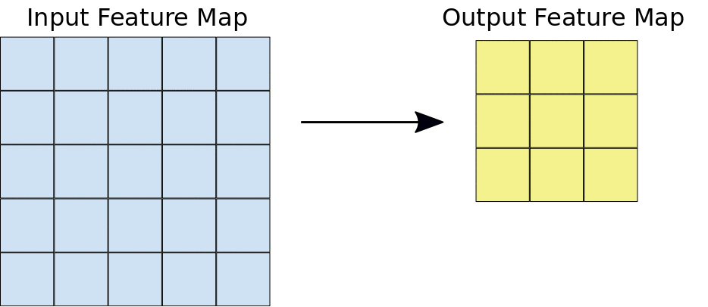
Drawback of convolution operation
3 x 3
Reduces the height and width of the output feature map
5 x 5

Slide 25
Zero padding
Address the issue of dimension reduction due to convolution
Zeros are added on each side of the input
Helps to keep the same input dimension through the convolution operation
Without zero padding, each successive feature map would get smaller after the convolution operation

Slide 26
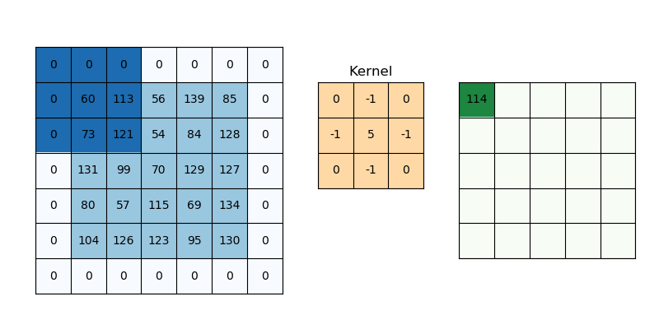
Zero padding
3 x 3
Output (5 x 5)
Original input: (5 x 5)
After zero padding: (7x7)

Slide 27
Stride
The distance between two successive kernel positions while convolving the input is called a stride
Common choice of stride is 1
Stride larger than 1 is sometimes used in order to achieve downsampling (reduce the height and width) of the feature maps

Slide 28
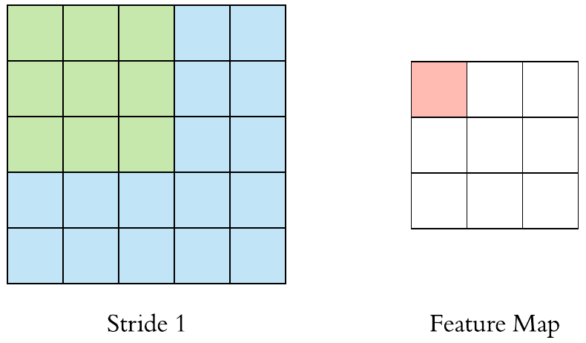
Stride

Slide 29
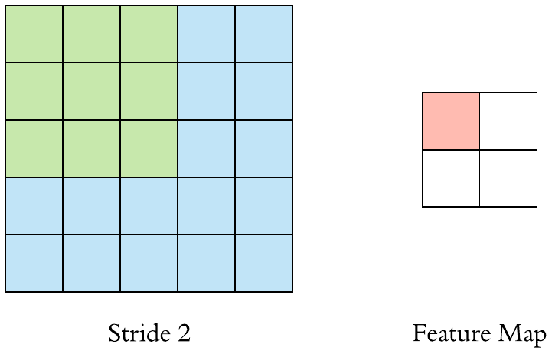
Stride

Slide 30

Convolution over channels

Slide 31
Convolution layer
How about the depth of a filter in CNNs?
The depth of a filter is implied. (i.e.,) it depends on the number of channels in the input
If an input has 3 channels, then a filter applied to that input must have a depth of 3
If an input has 32 channels, then a filter applied to that input must have a depth of 32

Slide 32
Bias
It is a trainable parameter of a convolutional layer
There is one bias for each output feature map
Each bias is added to every element in that output feature map
Its value shifts a model's predicted outcome either up or down depending on whether this bias value is positive or negative respectively
Size of bias in a convolutional layer is 1 x c
where c is the number filters in a convolutional layer

Slide 33
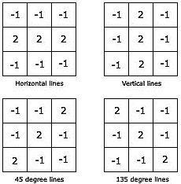
Convolution layer
Is one filter enough? No
One kernel can be used to extract one kind of feature
Different kernels should be used to extract different features
CNNs do not use a single filter; they, in fact, use multiple filters in parallel for a given input to extract different features from it

Slide 34
Convolution layer
How about the depth of the feature maps output by a convolutional layer?
Each filter (irrespective of its dimension and the dimension of the input) after convolving with the input results in a single feature map
Thus, if a convolutional layer has 32 filters, it results in 32 feature maps

Slide 35
Convolution layer
Assume a convolutional layer with 32 5 x 5 filters. It receives an input of dimension 32 × 32 × 16.
What will be the depth of a filter in the convolution layer? Why?
16, as the input has a depth of 16
What will be the depth of the output feature map?
32, as there are 32 filters

Slide 36
Convolution layer
In a CNN, the values of the filter weights are learned during the training of the network for a given task based on a given training dataset
Hyperparameters of the convolution operation
Size of kernel (3 × 3, 5 × 5, 7 × 7)
Number of kernels (16, 32, 64)
Padding
Stride

Slide 37
Convolution layer
Why do we need multiple convolution layers?
Convolutional layers are not only applied to input data, e.g. raw pixel values, but they can also be applied to the output of other layers
The stacking of convolutional layers allows a hierarchical decomposition of the input
The filters that operate directly on the raw pixel values will learn to extract low-level features, such as lines
The filters that operate on the output of the first line layers may extract features that are combinations of lower-level features, such as features that comprise multiple lines
This process continues until very deep layers extract objects (face/chair/table etc.,)

Slide 38
Output size of a convolutional layer
output_size =((input_size - filter_size + 2 * padding) / stride )+ 1
Example: An input of size 32x 32 x 64 is passed to a convolutional layer with 128 filters of size of 3 x 3, a padding of 1, and a stride of 1, the output size of the convolutional layer would be:
output_size = ((32 - 3 + 2 * 1) / 1 )+ 1 = 32 x 32 x 128
This means that the output of the convolutional layer would be 128 feature maps each of size 32 x 32

Slide 39
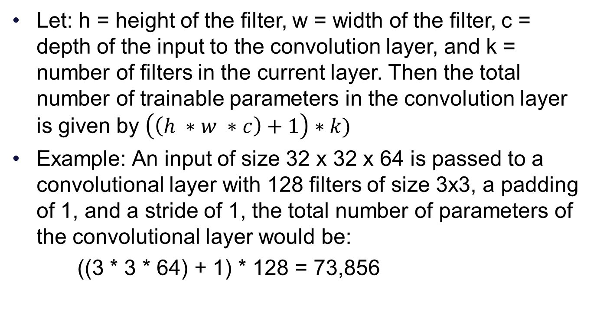
Number of learnable parameters of a convolution layer
Let: h = height of the filter, w = width of the filter, c = depth of the input to the convolution layer, and k = number of filters in the current layer. Then the total number of trainable parameters in the convolution layer is given by $\left(\left(h ∗w ∗c\right)+1\right)∗k)$
Example: An input of size 32 x 32 x 64 is passed to a convolutional layer with 128 filters of size 3x3, a padding of 1, and a stride of 1, the total number of parameters of the convolutional layer would be:
((3 * 3 * 64) + 1) * 128 = 73,856

Slide 40
Nonlinear activation functions
The outputs of the convolution operation (feature maps) are passed through a nonlinear activation function
Different activation functions may be used in different parts of the model for different purpose
The output layer will use a activation depending on the type of prediction required by the model
Nonlinear activation functions:
Sigmoid (Logistic)
Softmax
Hyperbolic tangent (tanh) function
Rectified linear unit (ReLU)

Slide 41
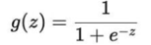
Sigmoid activation function
The function takes any real value as input and outputs values in the range 0 to 1
The larger the input (more positive, +inf), the closer the output value will be to 1, whereas the smaller the input (more negative, -inf), the closer the output will be to 0
The sigmoid activation function is given as follows

Slide 42
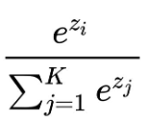
Softmax activation function
While sigmoid works on a single input, softMax takes a vector of real valued inputs
It then converts each real value to a value in the range of 0 – 1 (The sum of all the values is 1)
It is used as the activation function of the output layer
it takes a vector with the same number of entries as classes
outputs another vector where each component represents the probability of belonging to that class
The softmax activation function is given as follows:
S(z_{i}) =

Slide 43
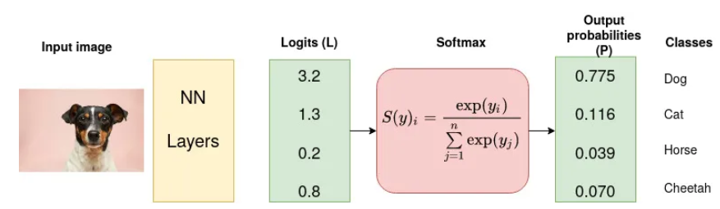
Softmax activation function
The following values are input to a softmax activation function: 3.2, 1.3, 0.2, 0.8
Compute the output values of the softmax activation function

Slide 44
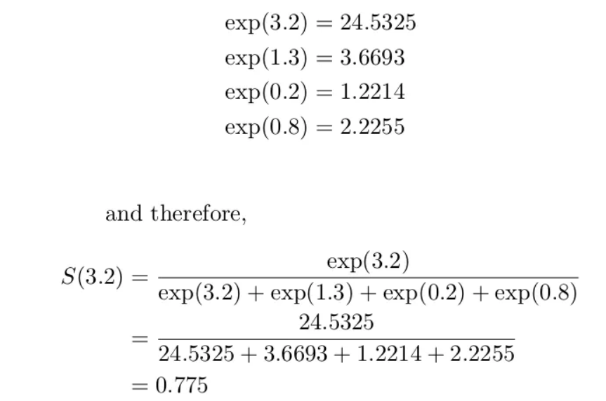
Softmax activation function

Slide 45
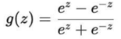
Tanh activation function
The function takes any real value as input and outputs values in the range -1 to 1
The larger the input (more positive), the closer the output value will be to 1, whereas the smaller the input (more negative), the closer the output will be to -1
Can lead to explosion or vanishing issue
The tanh activation function is given as follows:

Slide 46
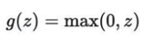
ReLU activation function
Commonly used: simple to implement and effective
It is less susceptible to vanishing gradients
It will output the input directly if it is positive, otherwise, it will output zero
The ReLU activation function is given as follows

Slide 47
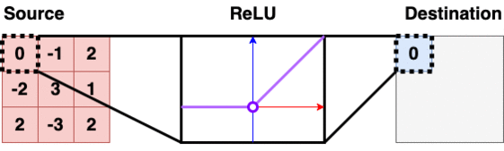
ReLU activation function

Slide 48
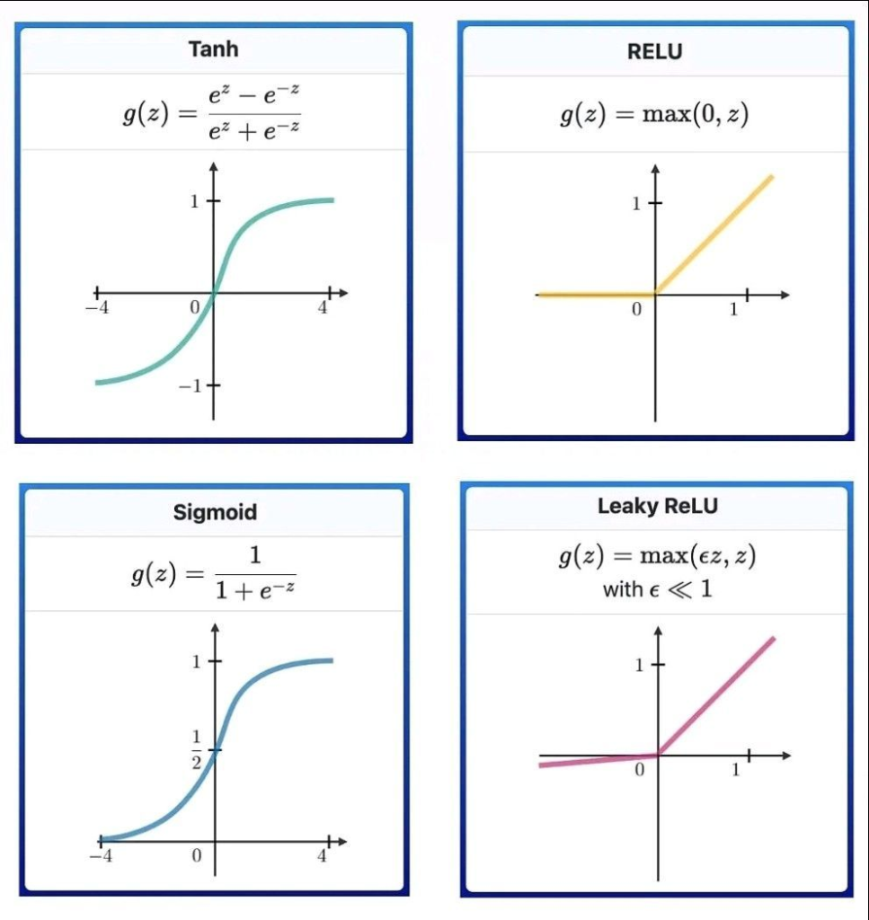
Nonlinear activation functions

Slide 49
Pooling layer
Downsampling operation: Reduces the dimension (width and height) of the feature maps
Summarize the presence of features in patches of the feature map
Operates upon each feature map separately to create a new set of the same number of pooled feature maps
Size of the pooling operation or filter
Usually, it is almost always 2×2 applied with a stride of 2 which reduces the size of each feature map by a factor of 2

Slide 50
Pooling layer
Advantages
Translation invariance: Down sampled feature maps are more robust to changes in the position of the feature in the image
Decrease the number of subsequent learnable parameters

Slide 51
Max pooling
Summarize the most activated presence of a feature
For each patch from the input feature map
Outputs the maximum value in each patch
Discards all the other values

Slide 52

Max pooling

Slide 53
Average pooling
Summarize the average presence of a feature
For each patch from the input feature map
Output the average value of each patch

Slide 54
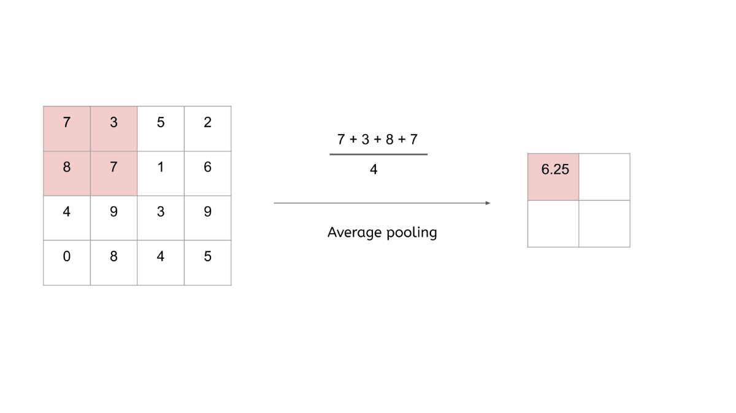
Average pooling

Slide 55
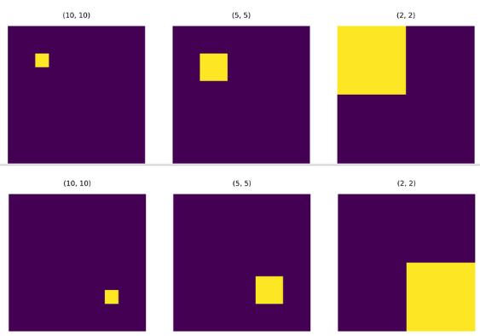
Translation invariance of pooling operation
Consider the image.
The yellow pixel at index [2, 2] on the top left is moved to index [7, 7] in bottom left.
It can be said that the pixel has undergone translation from the top left corner to the bottom right corner.

Slide 56
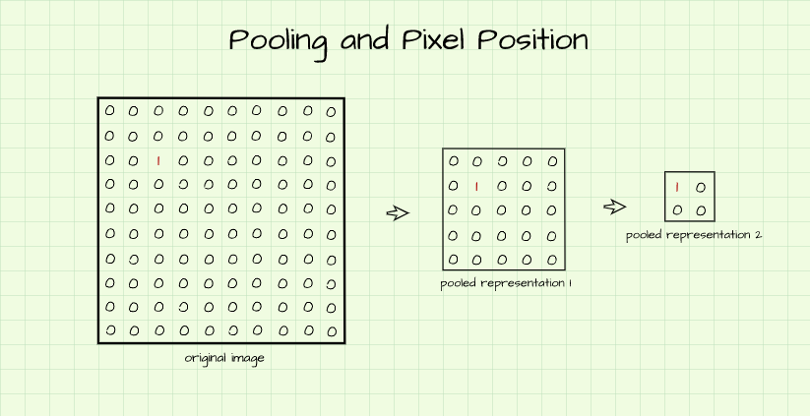
Translation invariance of pooling operation

Slide 57
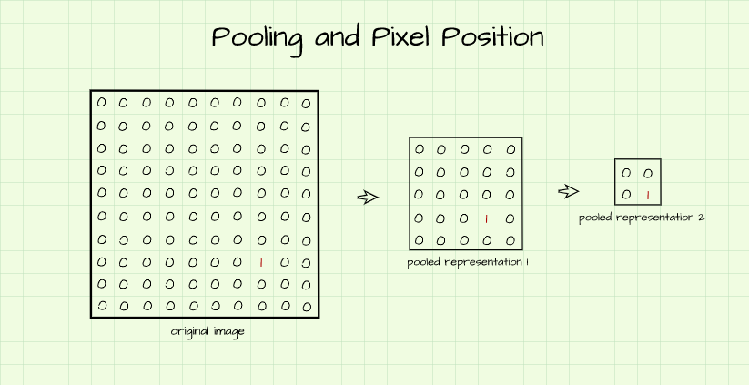
Translation invariance of pooling operation

Slide 58
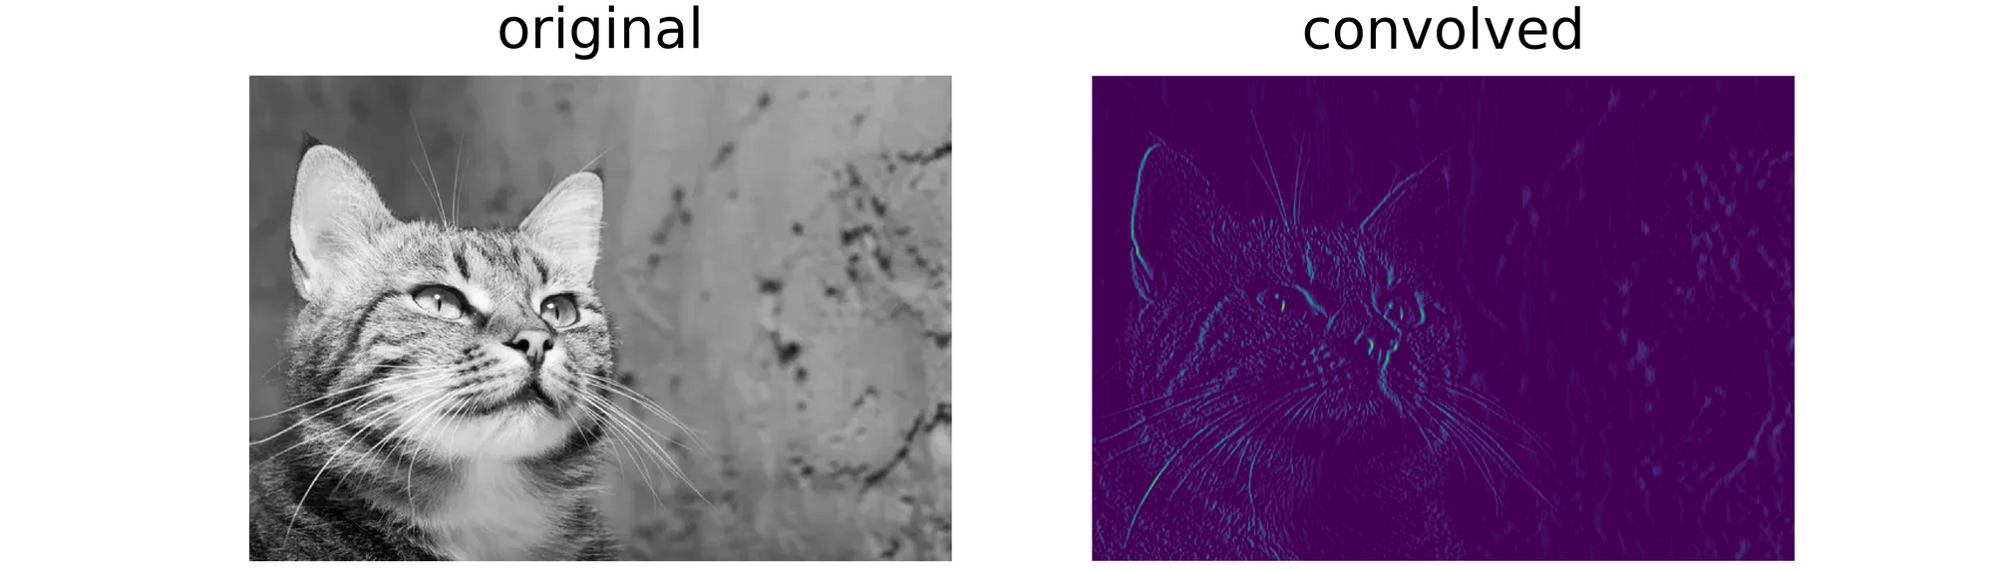
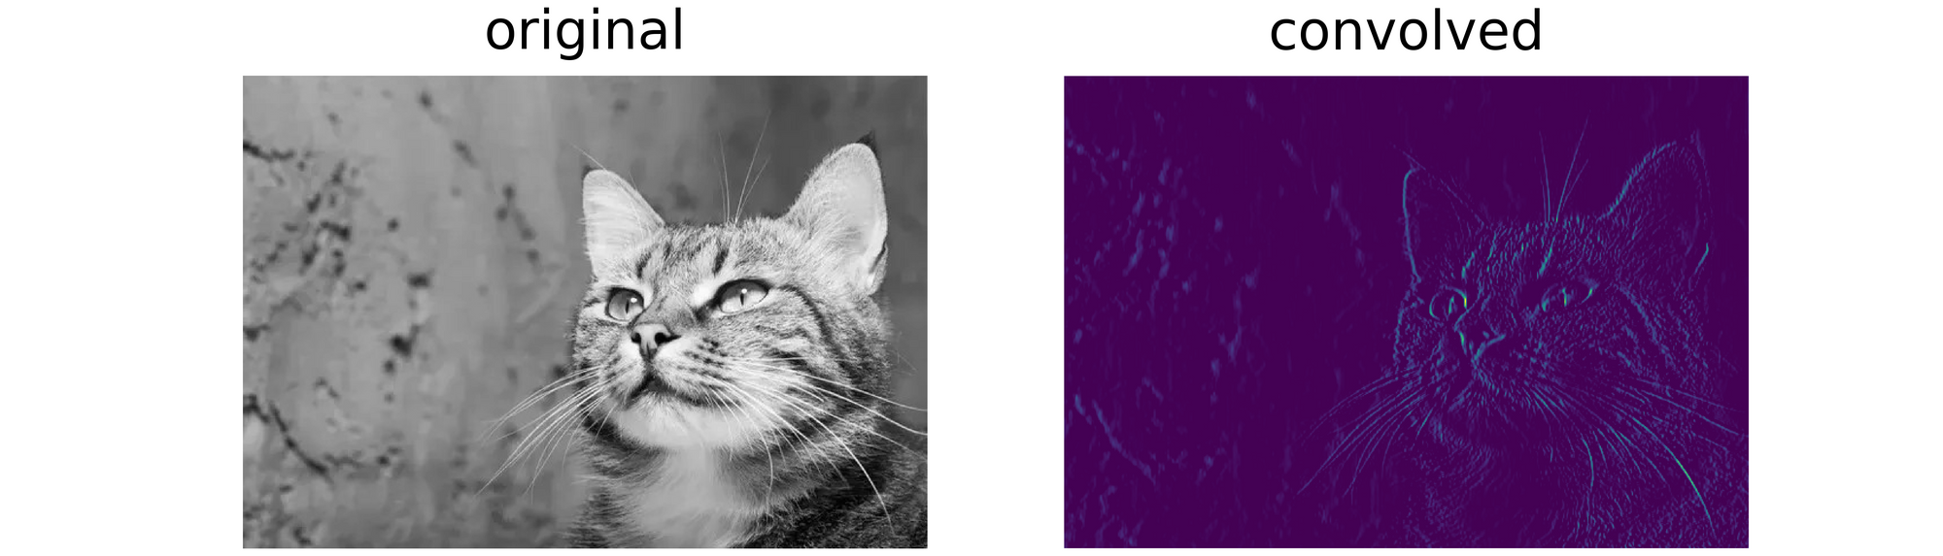
Translation invariance of pooling operation

Slide 59
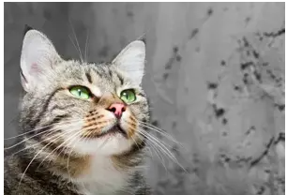
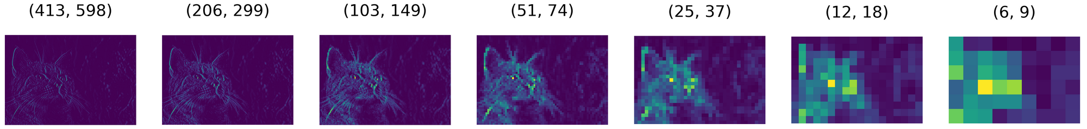
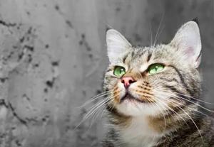
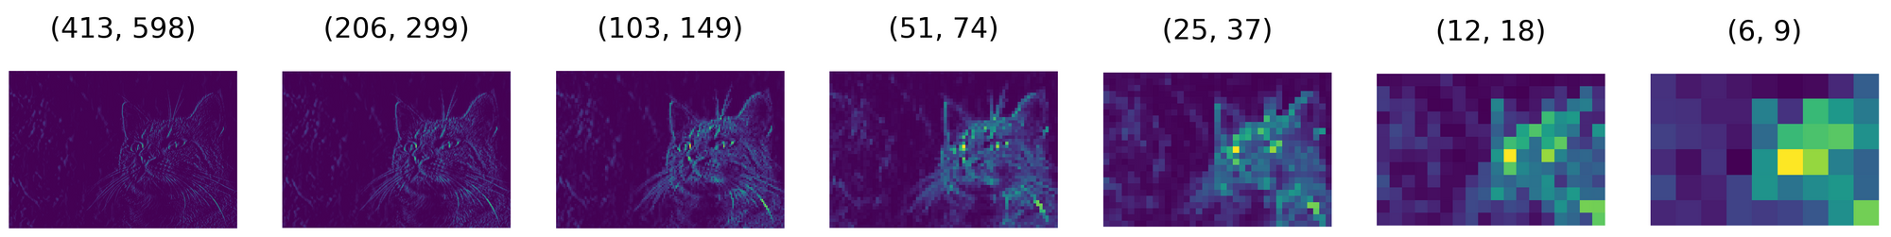
Translation invariance of pooling operation

Slide 60
Pooling layer
There is no learnable parameter in any of the pooling layers
Hyperparameters are
Filter size (default = 2 × 2)
Stride (default = 2)

Slide 61
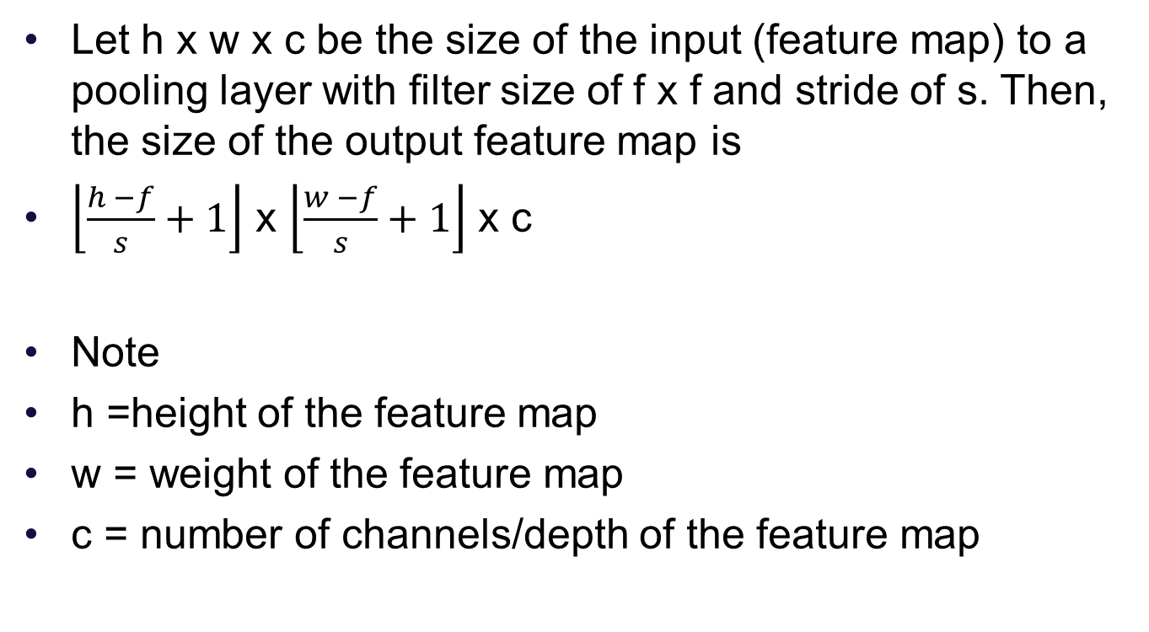
Output size of a pooling layer
Let h x w x c be the size of the input (feature map) to a pooling layer with filter size of f x f and stride of s. Then, the size of the output feature map is
$\left\lfloor \frac{h −f}{s}+1\right\rfloor$ x $\left\lfloor \frac{w −f}{s}+1\right\rfloor$ x c
Note
h =height of the feature map
w = weight of the feature map
c = number of channels/depth of the feature map

Slide 62
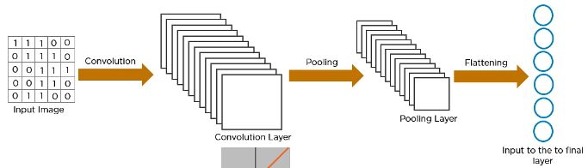
Flatten layer
Flattening is used to convert all the 2-D feature maps into a 1-D linear vector
Pooled feature maps
Feature maps

Slide 63
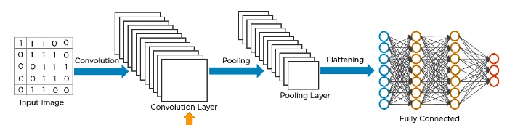
Flatten layer
Why do we need flatten layer?
The flattened vector is fed as input to a artificial neural network (fully connected layer) to classify the image
Pooled feature maps
Feature maps

Slide 64
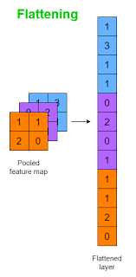
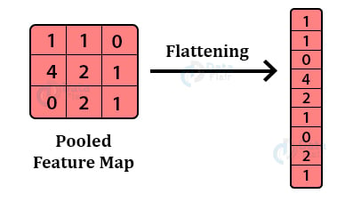
Flatten layer

Slide 65
Size of flatten layer
Size = dimensions of the output feature map * the number of filters in the last convolutional layer
Example: The output of a convolutional layer that has 64 filters is a feature map size of 32 × 32. If this output is flattened, then find the size of the flatten layer: 64*32*32 = 65536

Slide 66
Global average pooling
A global average pooling layer is used to convert a 2-D feature map into a single value
It performs downsampling, where a feature map with size of height × width is downsampled into a 1 × 1 array by taking the average of all the elements in each feature map, whereas the depth of feature maps is retained
It is used to replace the flatten and fully connected layers in a CNN

Slide 67
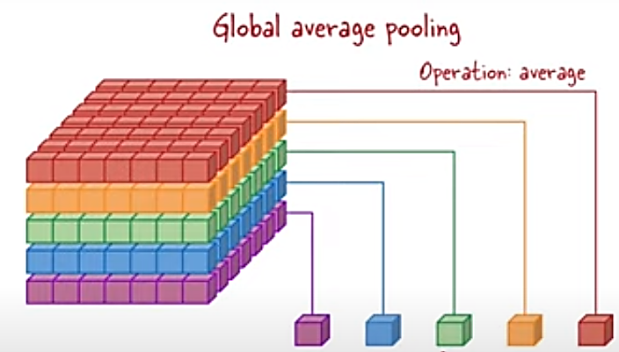
Global average pooling

Slide 68
Global max pooling
Similar to global average pooling, global max pooling converts a 2-D feature map into a single value
It performs downsampling, where a feature map with size of height × width is downsampled into a 1 × 1 array by taking the maximum of all the elements in each feature map, whereas the depth of feature maps is retained

Slide 69
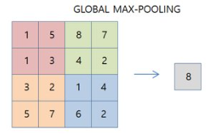
Global max pooling

Slide 70
Fully connected (dense) layer
The flattened output is connected to one or more dense layer
A fully connected layer has a linear set of neurons
A fully connected layer's neurons are connected to all of the neurons in the next layer by a learnable weight
Each fully connected layer is followed by a nonlinear activation function
The dense layers map the features extracted by the earlier layers into the final outputs of the network

Slide 71
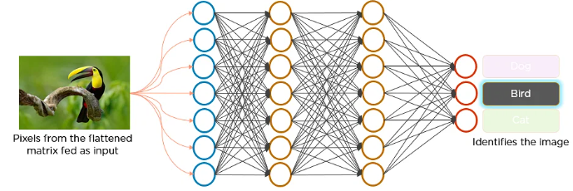
Fully connected layer

Slide 72
Fully connected layer
The number of parameters in a fully connected layer are: ((current layer neurons c * previous layer neurons p)+1*c)

Slide 73
Output layer
The final fully connected layer is the output layer
It has the same number of output nodes as the number of classes
Activation function of the output layer:
Softmax activation function: multiclass classification
Sigmoid activation function: binary classification

Slide 74
Training a CNN
How does a CNN learn features automatically from the raw input data?
Training the CNN on the input data
What is meant by training a CNN?
It is the process of finding the weights of
Kernels in convolution layers
Fully connected layers
What are the steps in training?
Forward propagation
Back propagation
Done for multiple iterations over the input data

Slide 75
Training a CNN
What is forward propagation?
The step where input data are transformed into output predictions through the layers is called forward propagation
What is back propagation?
Performs a backward pass to adjust a neural network model's parameters, such that the differences between output predictions and given input on a training dataset is minimized

Slide 76

Training a CNN

Slide 77
Training a CNN
What is a loss (cost) function
Measures how similar/close the output predictions of the network obtained through forward propagation and the given input (ground truth labels)
Loss function
Cross entropy (multiclass classification)
Mean squared error (Regression)
The type of loss function is one of the hyperparameters and needs to be determined according to the given tasks

Slide 78
Regularization technique
The Dropout layer is a regularization technique used in Convolutional Neural Networks (CNNs) to prevent over fitting. It works by randomly dropping out some percentage of neurons in the network during training, which helps to reduce the size of the model and enhance its learning
When a neuron is dropped out, it means that it is ignored during both forward and backward passes of the training process. This forces the network to learn redundant representations of the data, which makes it more robust and less prone to over fitting

Slide 79


Slide 80
Popular pretrained CNNs
LeNet
VGG
AlexNet
ResNet
InceptionNet
XceptionNet
GoogleNet
MobileNet
These networks can be used to solve a new task using transfer learning

Slide 81
Frameworks
Few most popular open-source deep learning frameworks (i.e., packages) are listed below:
Caffe: https://github.com/BVLC/caffe
Tensorflow: https://github.com/tensorflow/tensorflow
Theano: https://github.com/Theano/Theano
Torch7/PyTorch-: https://github.com/torch/torch7 or https://github.com/pytorch/pytorch
MXNet: https://github.com/apache/incubator-mxnet

Slide 82
Top conferences in computer vision
IEEE / CVF Computer Vision and Pattern Recognition Conference (CVPR)
International Conference on Computer Vision (ICCV)
British Machine Vision Conference (BMVC)
IEEE International Conference on Image Processing (ICIP)
Asian Conference on Computer Vision (ACCV)
International Conference on Computer Vision Theory and Applications
Indian Conference on Computer Vision, Graphics & Image Processing (ICVGIP)

Slide 83
Top conferences in ML/AI
Conference on Neural Information Processing Systems (NeurIPS)
International Conference on Machine Learning (ICML)
International Joint Conference on Artificial Intelligence (IJCAI)

Slide 84
References
Jordan, Michael I., and Tom M. Mitchell. "Machine learning: Trends, perspectives, and prospects." Science 349.6245 (2015): 255-260.
LeCun, Yann, Yoshua Bengio, and Geoffrey Hinton. "Deep learning." nature 521.7553 (2015): 436-444.
Yamashita, Rikiya, et al. "Convolutional neural networks: an overview and application in radiology." Insights into imaging 9 (2018): 611-629.
Jason Brownlee, "How to Choose an Activation Function for Deep Learning", Deep Learning, 2021.
Jason Brownlee, "How Do Convolutional Layers Work in Deep Learning Neural Networks?", Deep Learning for Computer Vision, 2019.

Slide 85
References
Jia Y, Shelhamer E, Donahue J, Karayev S, Long J, Girshick R, et al. Caffe: Convolutional architecture for fast feature embedding. In: Proceedings of the 22nd ACM international conference on Multimedia; 2014 Nov 3–7; New York, NY, USA. New York: ACM; 2014. p. 675–8.
Abadi M, Agarwal A, Barham P, Brevdo E, Chen Z, Citro C, et al. Tensorflow: large-scale machine learning on heterogeneous distributed systems. 2016. arXiv: 1603.04467.
Bastien F, Lamblin P, Pascanu R, Bergstra J, Goodfellow L, Bergeron A, et al. Theano: new features and speed improvements. 2012. arXiv: 1211.5590.
Collobert R, Kavukcuoglu K, Farabet C. Torch7: a matlab-like environment for machine learning. In: Proceedings of the NIPS 2011 Workshop; 2011 Dec 12–17; Granada, Spain, 2011.

Slide 86
References
Chen T, Li M, Li Y, Lin M, Wang N, Wang M. MXNet: a flexible and efficient machine learning library for heterogeneous distributed systems. 2015. arXiv: 1512.01274.
https://www.cs.toronto.edu/~lczhang/360/lec/w04/convnet.html

Slide 87

Tutorial: CNN Image Classification with Keras and CIFAR-10

Slide 88


Step 1: Choose a Dataset
CIFAR-10 dataset, which consists of 60,000 32×32 color images across ten classes, with 6,000 images in each class.
Step 2: Prepare the Dataset for Training
splitting the dataset into training and test sets, and then normalizing the pixel values of the images to the range of 0 to 1
Step 3: Create Training Data and Assign Labels

Slide 89

Step 4: Define and Train the CNN Model

Slide 90

Step 5: Test the Model’s Accuracy

Slide 91


Slide 92

Last-layer activation and loss function combinations

Slide 93
Thank you

